Slide 1

MIB
Midterm Presentation
Qifan Shi

Slide 2
Project Statement
Based on given taxi dataset, calculate estimate of taxi fare of any given path.
Column Name | Data | Column Name | Data
_id : | 55098e47de75ca8f13e055b2 | speed | 0
taxi_no : | B041C2 | angle | 0
date : | 2009-09-01 | occupy | 0
lon : | 114.107640 | unknown | 0
lat : | 22.570170 | time : | 00:00:23

Slide 3
Visualization
Tasks
Entire taxi flow
Individual trajectory
Tool
R Studio, Java

Slide 4
Analysis
Tasks
Taxi fare of given paths
Fare rank based on individual behavior
Other statistical analysis (e.g., occupation rate, company fare)
Tools
R Studio

Slide 5
Visualization – How to approach
Entire taxi flow
Showing all (list all, center)
Defining center and checking density ( day, month )
Individual trajectory
Displaying geo-info on map ( day, month )

Slide 6
Analysis – How to approach
Taxi fare of given paths
Defining a path
Mapping each records to a path
Fare rank based on individual behavior
Defining behavior groups (Suburb, DT)
Analyzing group by group

Slide 7
Modeling
Taxi fare prediction for a new path
Problem: lack of historical data of taxi and demand
Taxi fare prediction for a new taxi
Problem: lack of historical taxi data.

Slide 8
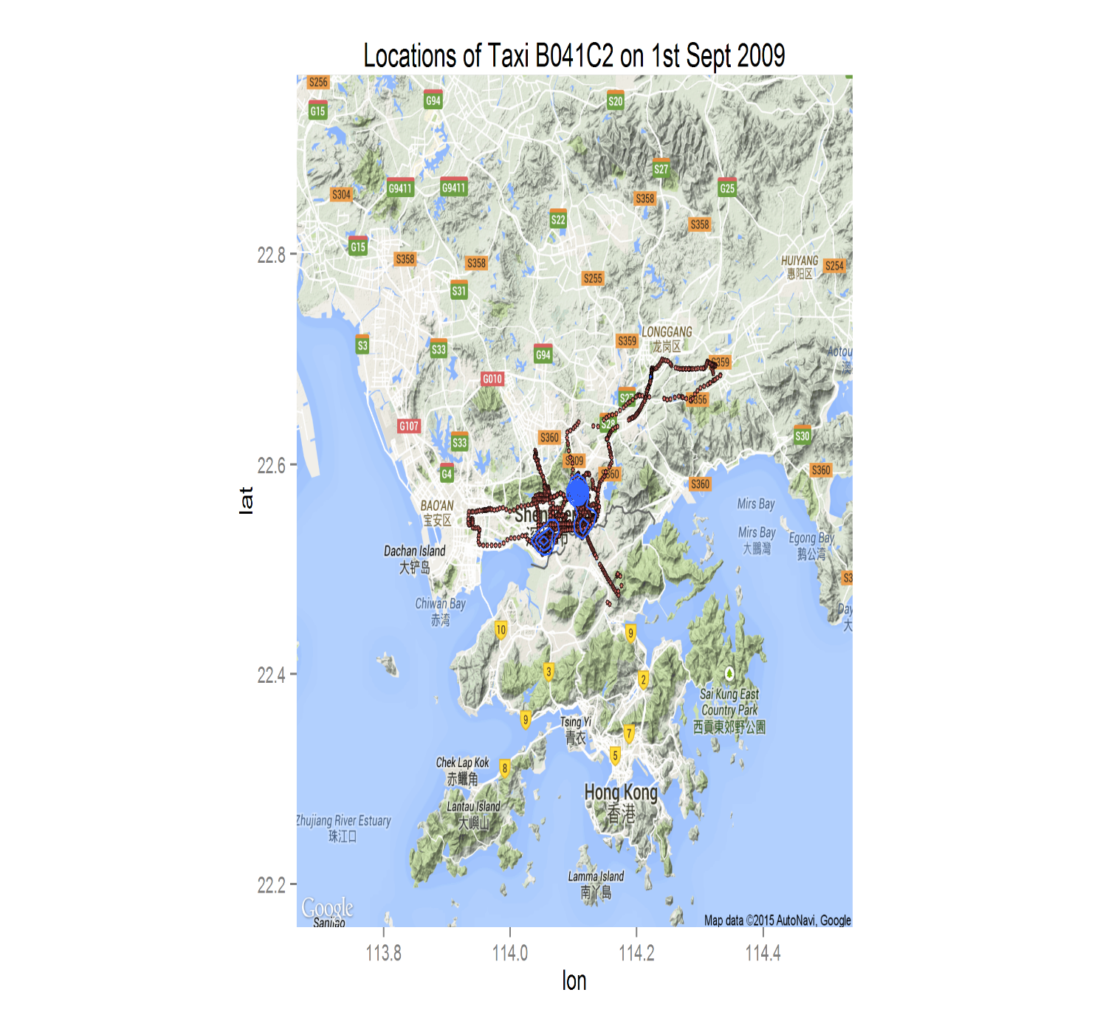
How Data Speaks!

Slide 9
Q & A
?

Slide 10

“All models are wrong,
but some are useful”

